Slide 1

Planning-Oriented Autonomous Driving (UniAD)
Unified perception, prediction & planning
July 26, 2025

Slide 2
Outline
Introduction & Motivation
UniAD Methodology
Perception: Tracking & Mapping
Prediction: Motion Forecasting
Prediction: Occupancy Prediction
Planning & Learning
Experiments & Results
Conclusion & Future Work

Slide 3
Introduction & Motivation
Standalone
Multi‑Task
Planning‑Oriented
Independent models for perception, prediction & planning
Shared backbone with multiple task-specific heads
Unified system driven by planning goal
Error accumulation & misalignment
Negative transfer across tasks
Queries connect modules & reduce errors
Modern autonomous driving pipelines are often modular, leading to error accumulation across perception, prediction and planning. UniAD seeks to prioritize planning by revisiting preceding tasks and ensuring that all components contribute towards the ultimate goal.
[1][2]

Slide 4
UniAD Methodology
Multi‑Camera Input
BEV Encoder
TrackFormer
MapFormer
MotionFormer
OccFormer
Planner
BEV features are extracted from multi‑camera images and fed into transformer‑based modules. TrackFormer detects, tracks and represents agents (including the ego vehicle). MapFormer abstracts lanes, dividers & crossings to assist motion forecasting. MotionFormer predicts multi‑agent trajectories, OccFormer forecasts future occupancy, and the Planner produces a safe trajectory.
[3]

Slide 5
Perception: Tracking & Mapping
TrackFormer
Joint detection and multi‑object tracking
Introduces separate detection and track queries for newborn and existing agents
Self‑attention across frames aggregates temporal information
Includes an ego‑vehicle query to explicitly model the self‑driving car
MapFormer
Panoptic segmentation of lanes, dividers & crossings
Sparse map queries encode location & structure knowledge
Outputs only the updated queries to MotionFormer
[4][5]

Slide 6
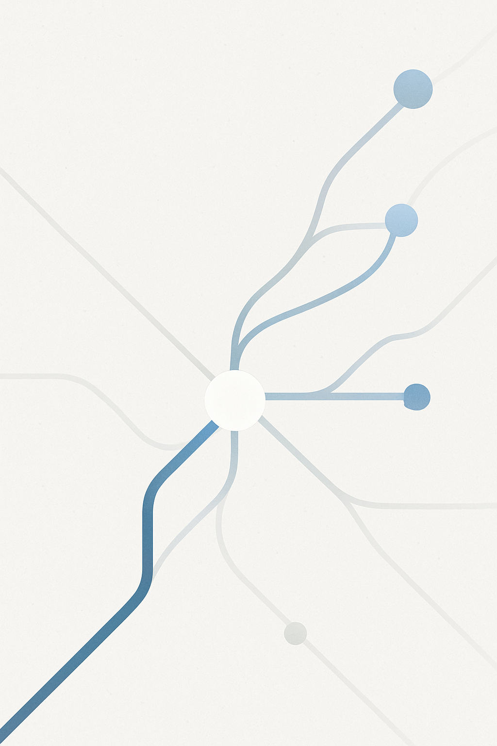
Prediction: Motion Forecasting
MotionFormer
Consumes queries from TrackFormer (agents) & MapFormer (static map) to predict multi‑modal trajectories for all agents
Single forward pass saves computational cost by operating in a scene‑centric manner
Captures agent–agent, agent–map & agent–goal interactions via multi‑head cross/self‑attention and deformable attention
Incorporates anchors & non‑linear smoothing to produce physically plausible trajectories
[6][7]

Slide 7
Prediction: Occupancy Prediction
OccFormer
Occupancy grid represents future occupancy of each BEV cell
Prior RNN‑based methods compress features and require hand‑crafted post‑processing
OccFormer fuses scene‑level and agent‑level semantics using attention and predicts instance‑wise occupancy via matrix multiplication
Sequential blocks unroll future horizons with pixel‑agent interaction for dense prediction
[8]

Slide 8
Planning & Learning
Planner
Combines navigation commands (left, right, forward) with the ego‑vehicle query to form a plan query
Attends to BEV features to produce future waypoints
Uses Newton’s method to adjust the trajectory and avoid collisions based on occupancy predictions
Learning Strategy
Two‑stage training: jointly train perception modules (tracking & mapping), then train all modules end‑to‑end
Bipartite matching reuses assignments across tasks to maintain consistent agent identity
[9][10]

Slide 9
Experiments & Results
Key Findings
Reduces motion prediction error by 38.3% vs PnPNet and 65.4% vs ViP3D
Improves occupancy IoU‑near by +4.0 and +2.0 compared to FIERY and BEVerse
Cuts planning L2 error & collision rate by over 50% compared to ST‑P3
[11][12][13]

Slide 10
Conclusion & Future Work
Conclusion
UniAD unifies perception and prediction tasks with a planning‑oriented philosophy
Query‑based design enables rich agent interactions and end‑to‑end optimisation
Extensive experiments show superior performance and improved safety
Future Work
Develop lightweight variants suitable for deployment on resource‑constrained platforms
Integrate additional tasks such as depth estimation and behavior prediction
Explore more efficient coordination between modules
[14]

